Slide 1

PTAci- Training Tip Sheet
Mobile Hand Held Functions
For Training Purposes Only

Slide 2
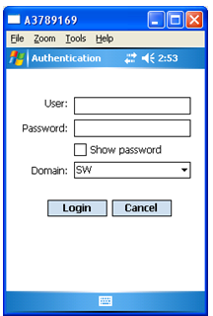
Mobile Hand Held Functions (Log On)
Either scan your employee badge or
type in your BEMSID
Type in your Windows/Network
password which is case sensitive
Click the Login Button to get to
the Main Menu
NOTE: If login is unsuccessful, an error
message will be displayed, and
you can try again
1
2
3
For Training Purposes Only

Slide 3
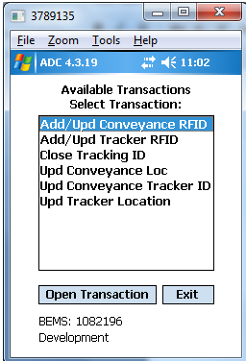
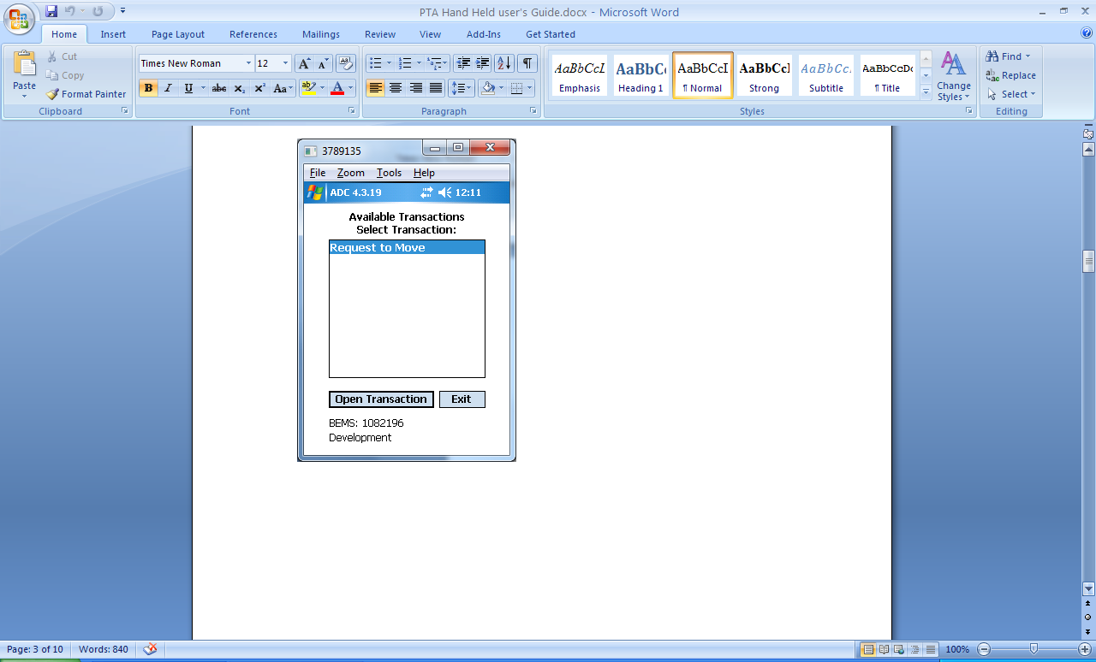
Mobile Hand Held Functions (Main Menu)
The Main Menu shows a list of all
your available Transactions
Contact your PTA Focal if…
The list is empty, or the transaction
you want is not in the list
If a message appears on the
menu and your transaction
is not on the list
For Training Purposes Only

Slide 4
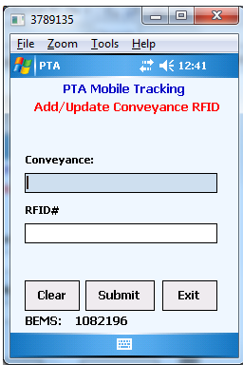
Mobile Hand Held Functions (Add/Update Conveyance RFID)
Select the “Add/Update Conveyance RFID”
Transaction from the Main Menu to get
to this screen
Scan a conveyance barcode, which then appears
Scan an RFID barcode or key in the number
Click Submit to execute this transaction
Click Clear to remove all input
Click Exit to close this screen and return
to the Main Menu
1
2
If transaction successful, message “Transaction
successful” will be displayed. If not, message
“Transaction failed” will be displayed with a pop up
box for details.
4
3
5
For Training Purposes Only

Slide 5
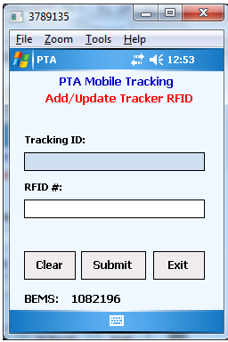
Mobile Hand Held Functions (Add/Update Tracker RFID)
Select the “Add/Update Tracker RFID”
Transaction from the Main Menu to get
to this screen
Scan a tracker barcode, which then appears
Scan an RFID barcode or key in the number
Click Submit to execute this transaction
Click Clear to remove all input
Click Exit to close this screen and return
to the Main Menu
1
2
If transaction successful, message “Transaction
successful” will be displayed. If not, message
“Transaction failed” will be displayed with a pop up
box for details.
4
3
5
For Training Purposes Only

Slide 6
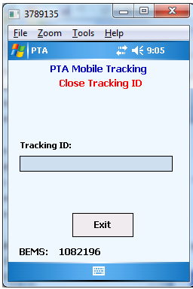
Mobile Hand Held Functions (Close Tracking ID)
Select the “Close Tracking ID”
Transaction from the Main Menu to get
to this screen
Scan a tracker barcode, to auto execute
the transaction which has no submit button
2. Click Exit to close this screen and return
to the Main Menu
1
2
If transaction successful, message “Transaction
successful” will be displayed. If not, message
“Transaction failed” will be displayed with a pop up
box for details.
For Training Purposes Only

Slide 7
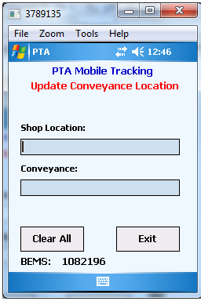
Mobile Hand Held Functions (Update Conveyance Location)
Select the “Update Conveyance Location”
Transaction from the Main Menu to get
to this screen
Scan a shop location barcode
Scan an conveyance barcode
Bar codes can be scanned in any order, and
transaction will auto execute with no submit
button when both have been scanned
3. Click Clear to remove all input
4. Click Exit to close this screen and return
to the Main Menu
1
2
3
4
If transaction successful, message “Transaction
successful” will be displayed. If not, message
“Transaction failed” will be displayed with a pop up
box for details.
For Training Purposes Only

Slide 8
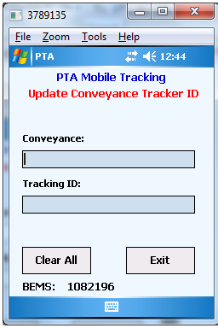
Mobile Hand Held Functions (Update Conveyance Tracker ID)
Select the “Update Conveyance Tracker ID”
Transaction from the Main Menu to get
to this screen
Scan a conveyance barcode
Scan a tracker barcode
Bar codes can be scanned in any order, and
transaction will auto execute with no submit
button when both have been scanned
3. Click Clear to remove all input
4. Click Exit to close this screen and return
to the Main Menu
1
2
If transaction successful, message “Transaction
successful” will be displayed. If not, message
“Transaction failed” will be displayed with a pop up
box for details.
3
4
For Training Purposes Only

Slide 9
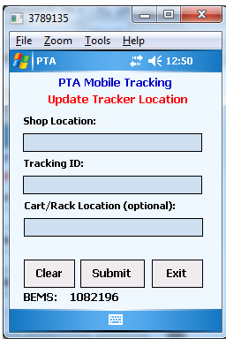
Mobile Hand Held Functions (Update Tracker Location)
Select the “Update Tracker Location”
Transaction from the Main Menu to get
to this screen (updates cart/rack location)
Scan a shop location barcode
Scan a tracker barcode
Optionally scan a cart/rack location (not required)
Bar codes can be scanned in any order
4. Click Submit to execute the transaction
5. Click Clear to remove all input
6. Click Exit to close this screen and return
to the Main Menu
1
2
3
If transaction successful, message “Transaction
successful” will be displayed. If not, message
“Transaction failed” will be displayed with a pop up
box for details.
5
4
6
For Training Purposes Only

Slide 10
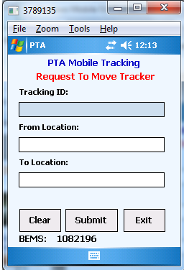
Mobile Hand Held Functions (Request to Move Tracker)
Select the “Request to Move Tracker”
Transaction from the Main Menu to get
to this screen
Scan a tracker barcode
Scan a From Location barcode, or key it in
Scan a To Location barcode, or key it in
Bar codes can be scanned in any order
4. Click Submit to execute the transaction
5. Click Clear to remove all input
6. Click Exit to close this screen and return
to the Main Menu
1
2
3
If transaction successful, message “Transaction
successful” will be displayed. If not, message
“Transaction failed” will be displayed with a pop up
box for details.
5
4
6
For Training Purposes Only

Slide 11
Mobile Hand Held Functions
For Training Purposes Only

